Slide 1

EDA Hotel Booking Management
Presenter : Dhvani Vaja
Co-presenter : Nancy Parsaniya
Guided By : Abhishek Wavhal

Slide 2
Summary of the Project
The Project has 3 years of Dataset for Hotel Booking.
The Data has various columns like :
Hotel: Type of hotel(City or Resort)
is_cancelled: If the booking was cancelled(1) or not(0)
lead_time: Number of days before the actual arrival of the guests
arrival_date_year: Year of arrival date
arrival_date_month: Month of arrival date
arrival_date_week_number: Week number of year for arrival date
arrival_date_day_of_month: Day of arrival date

Slide 3
Summary of the Project
Stays_in_weekend_nights: Number of weekend nights(Saturday or Sunday) spent at the hotel by the guests.
stays_in_weel_nights: Number of weeknights(Monday to Friday) spent at the hotel by the guests.
adults: Number of adults among the guests
children: Number of children
babies: Number of babies
meal: Type of meal booked
country: country of the guests
market_segment: Designation of market segment

Slide 4
Summary of the Project
distribution_channel: Name of booking distribution channel
is_repeated_guest: If the booking was from a repeated guest(1) or not(0)
previous_cancellation: Number of previous bookings that were cancelled by the customer prior to the current booking
previous_bookings_not_cancelled: Number of previous bookins not cancelled by the customer prior to the current booking
reserved_room_type: Code from room type reserved
assigned_room_type: Code of room type assigned
booking_changes: Number of changes made to the booking
deposit_type: Type of deposite made by the guest
agent: ID of travel agent who made the booking

Slide 5
Summary of the Project
comapny: ID of the company that made the booking
days_in_waiting_list: Number of the days the booking was in the waiting list
customer_type: Type of customer, assuming one of four categories
adr: Average daily rate
required_car_parking_spaces: Number of car parking spaces required by the customer
total_of_special_requesrs: Number of special requests made by the customer
reservation_statuse: Reservation status(Canceled, check-out or no-show)
reservation_status_date: Date at which the last reservation status was updated

Slide 6
Effects of Project
Improved efficiency
Enhanced customer
Increased revenue
Better resource management
Data insight
Competitive advantage

Slide 7


Contents
Data cleaning
Data visualization
Solution to business objective
conclusion

Slide 8
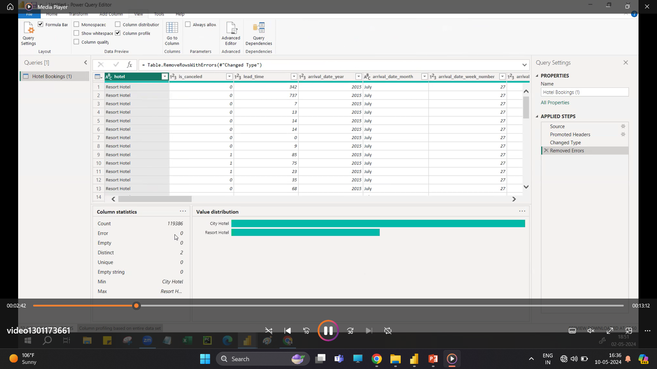
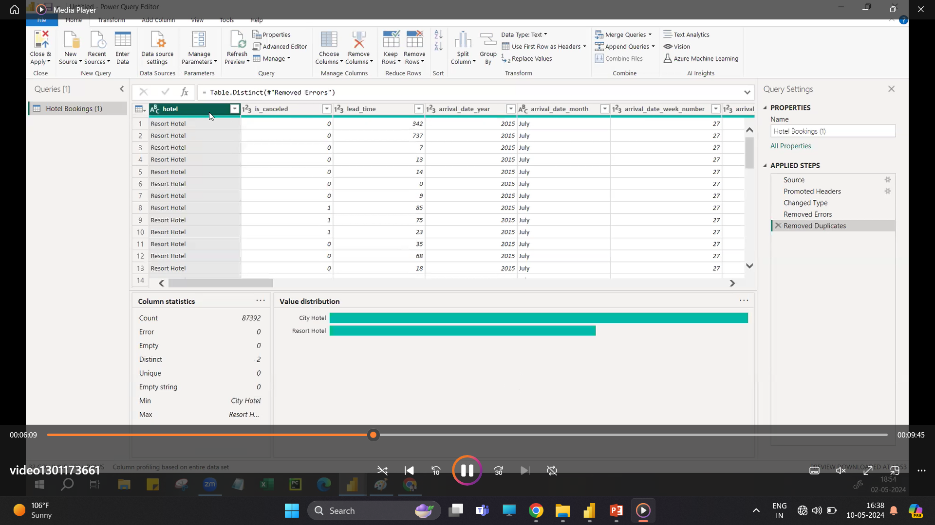
Data cleaning
Removed all the Duplicates.

Slide 9
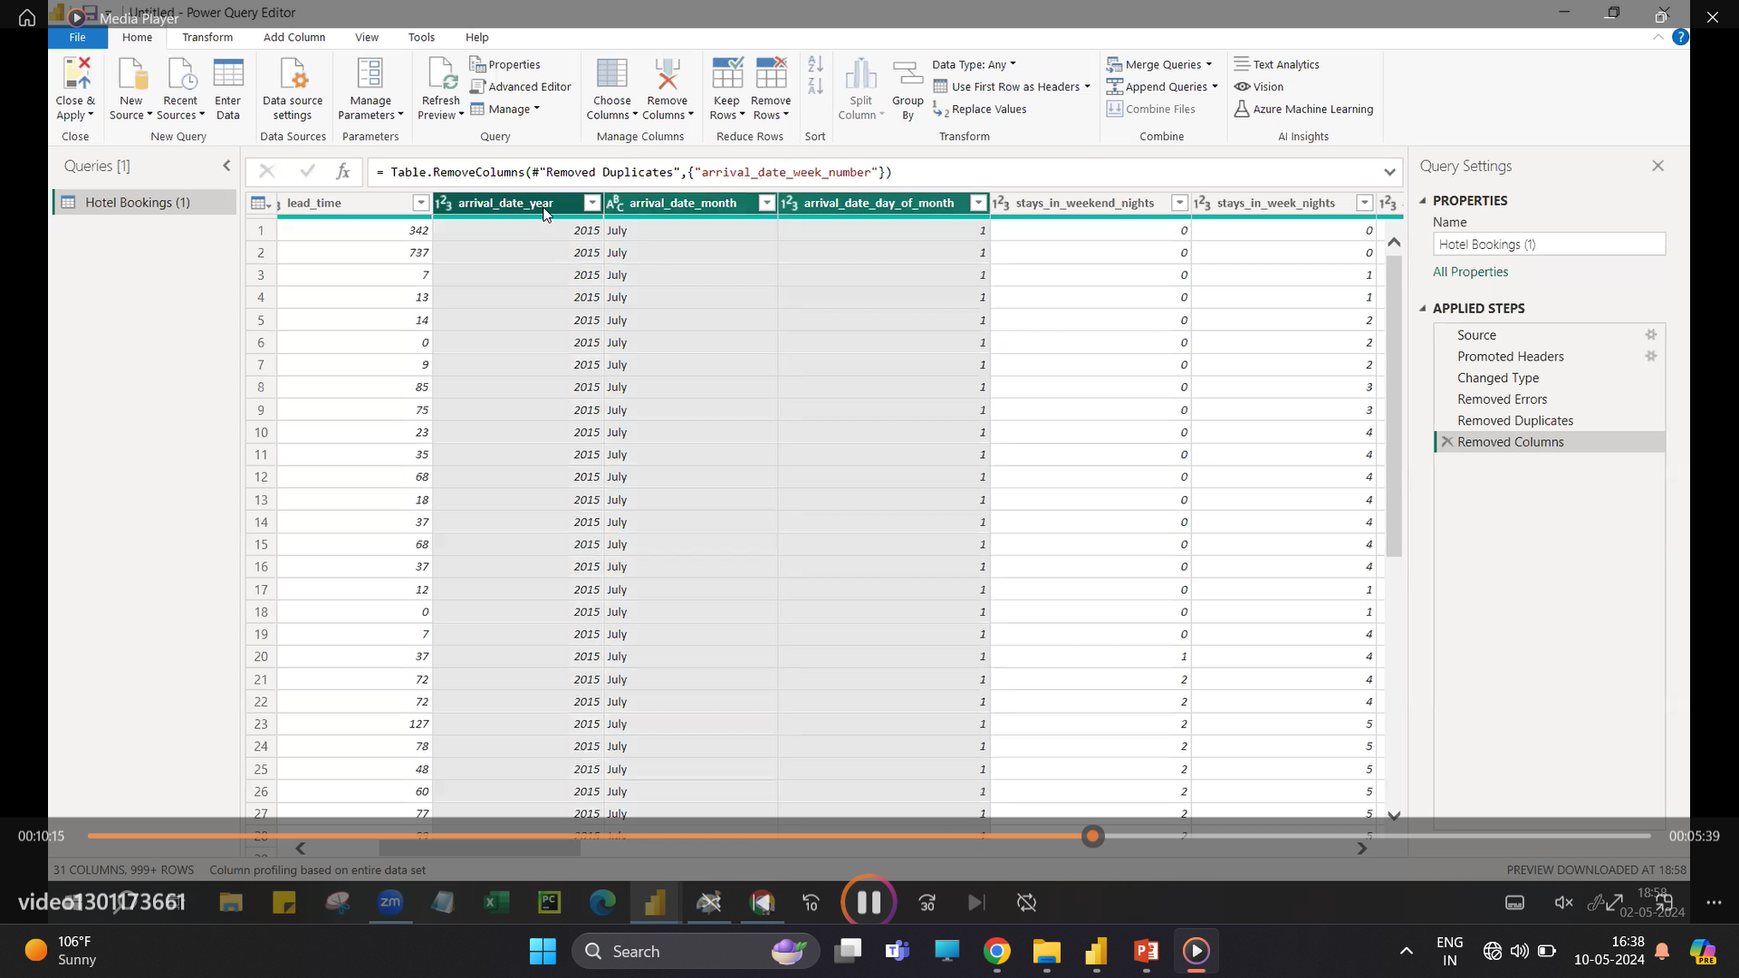
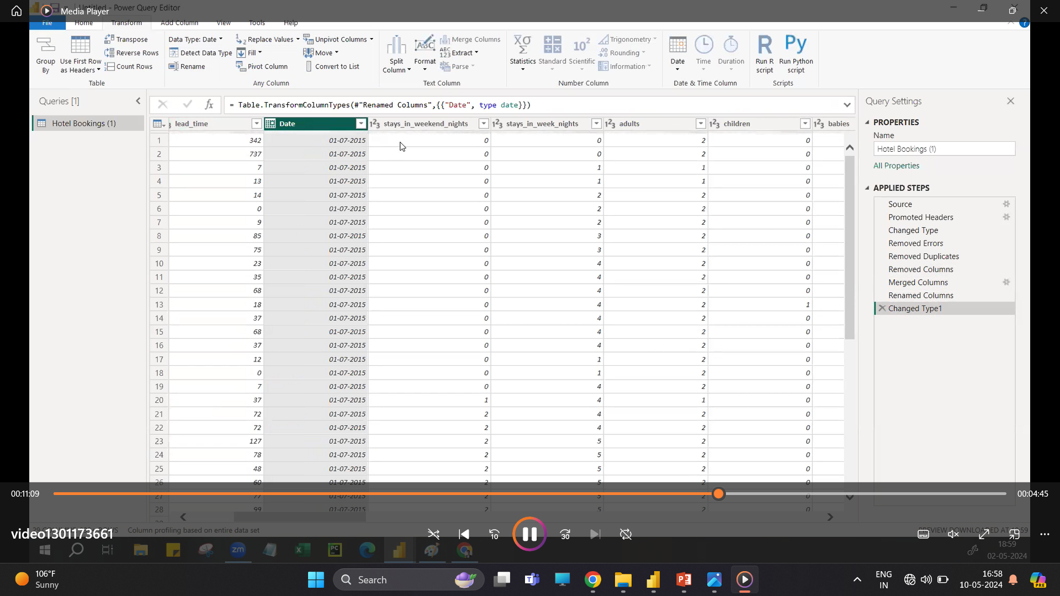
Date Cleaning
Merged Date columns and create New Date column.

Slide 10
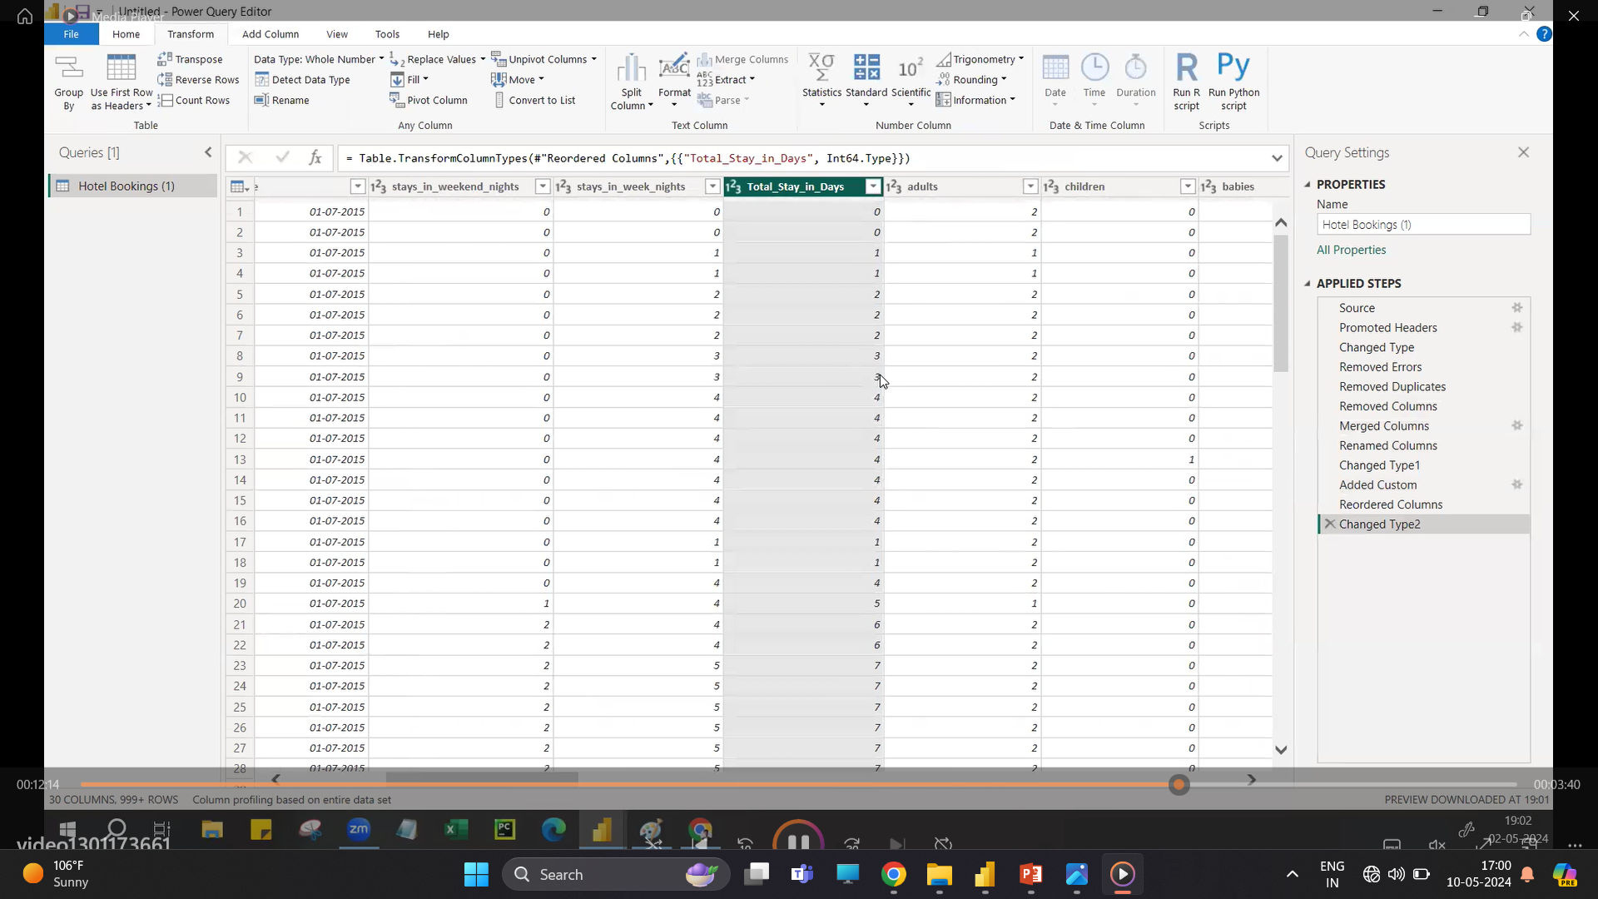
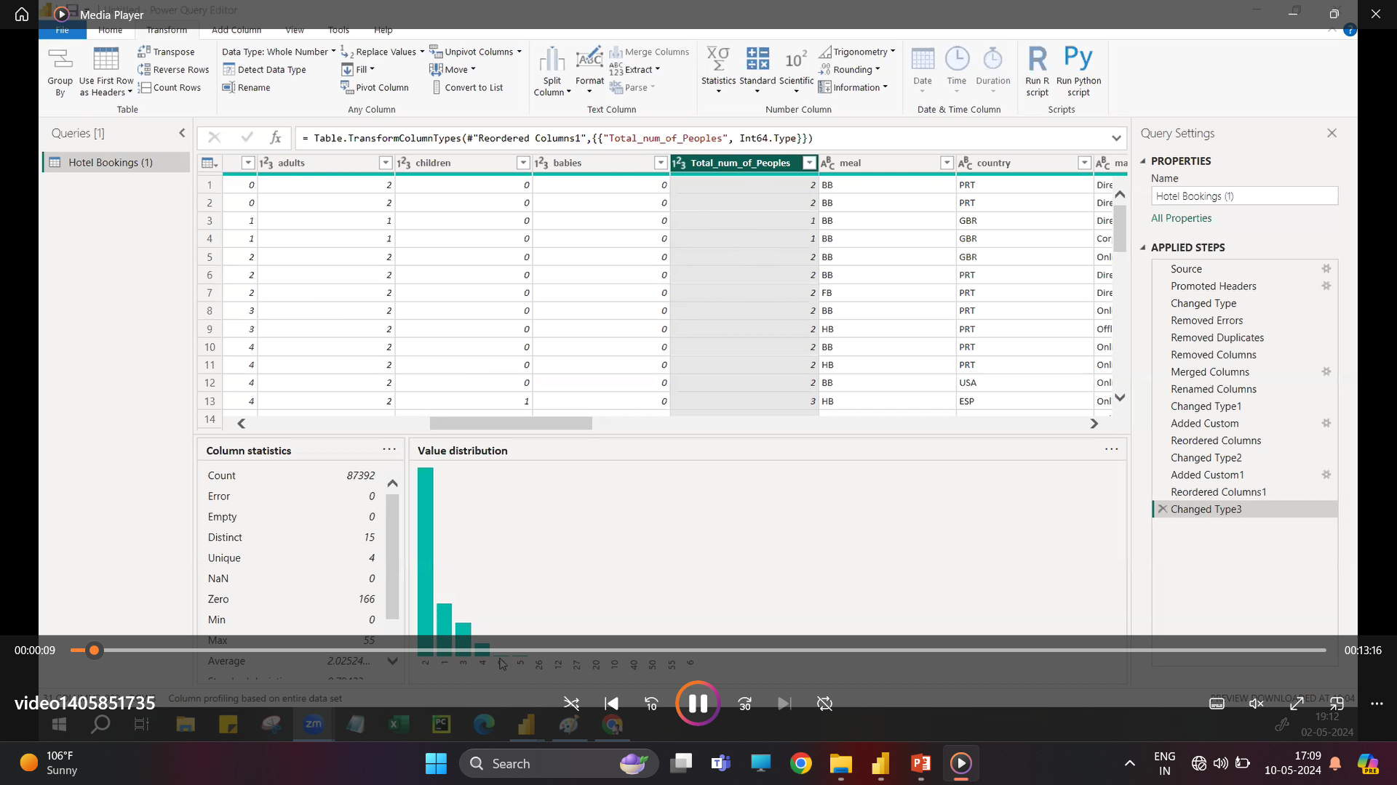
Data Cleaning
Custom the column weekend night and week night as Total_ stay_in_Nights.
Custom the column babies , adults and children as Total _num _of_ people.

Slide 11
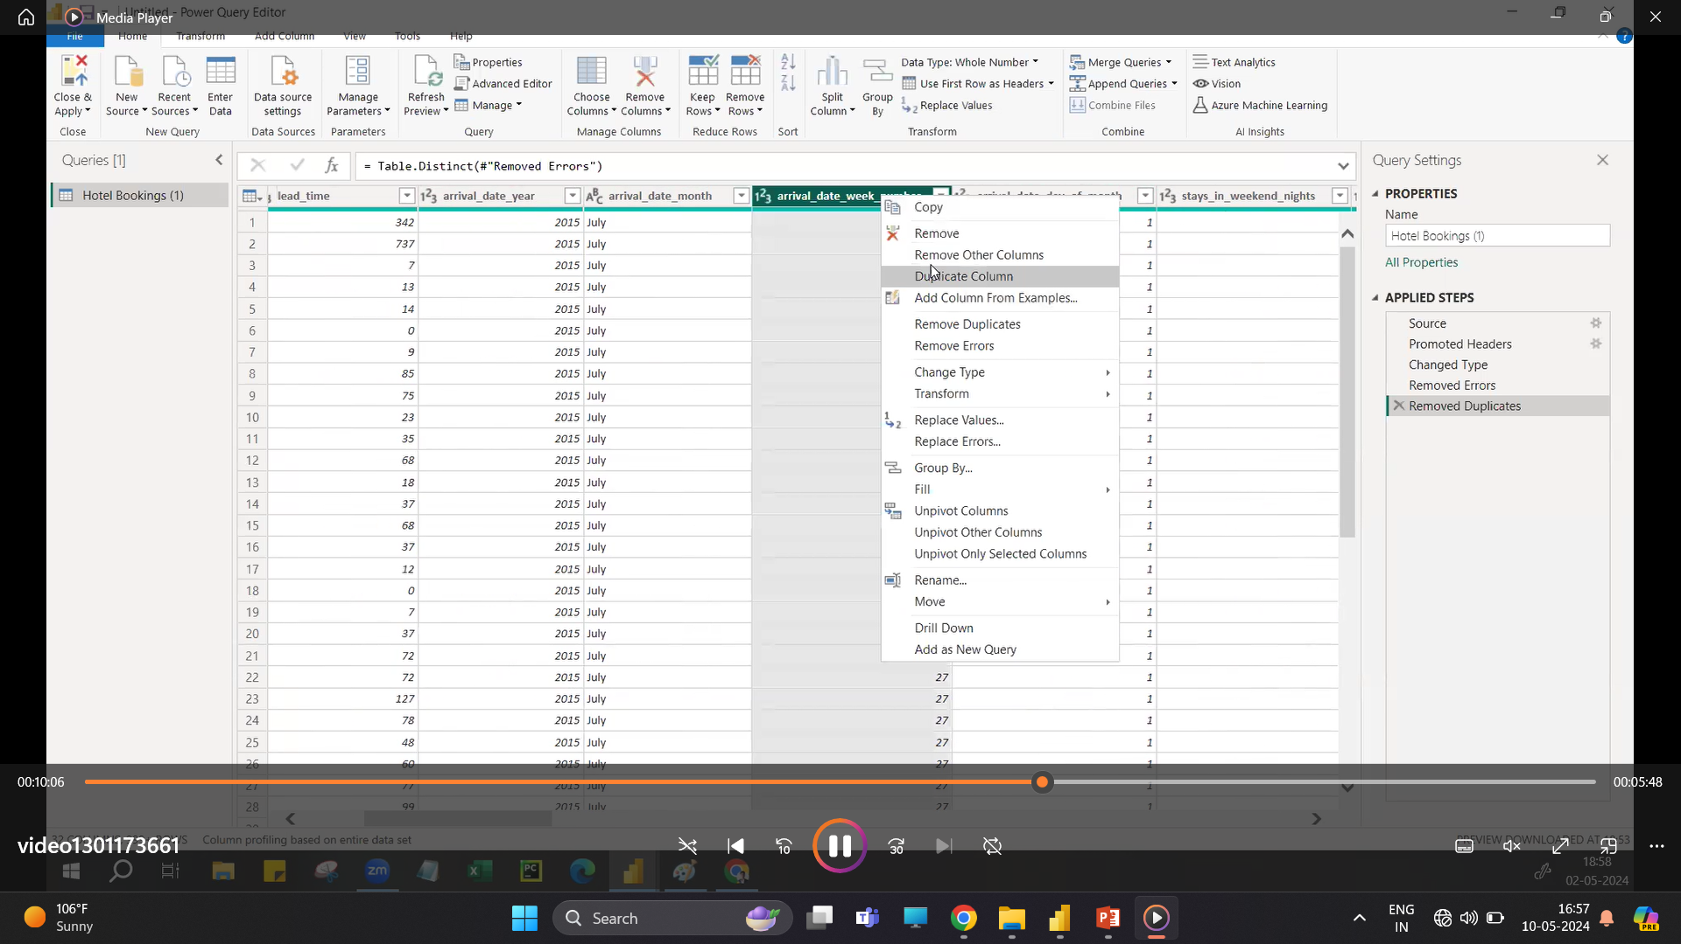
Data Cleaning
Delete the unwanted columns.

Slide 12
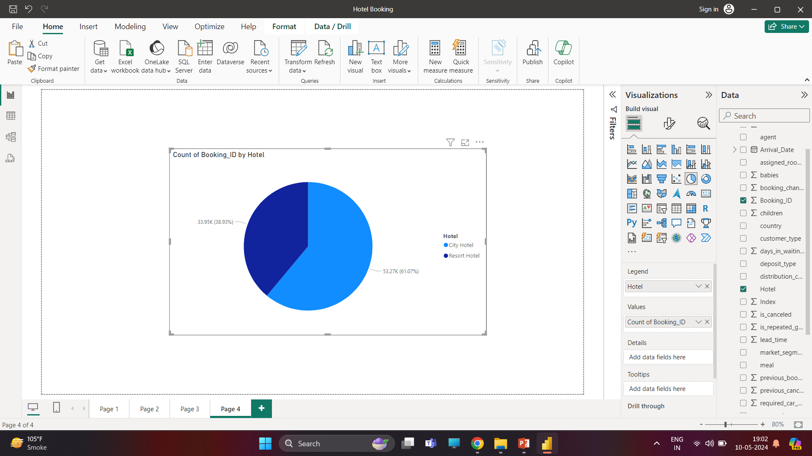
Data Visualisation
These chart represents this project have 2 Hotels.
We have more bookings for RESORT Hotel compare to City Hotel in term of percentage.
City Hotel: 38.3% booking
Resort Hotel : 61.07% booking

Slide 13
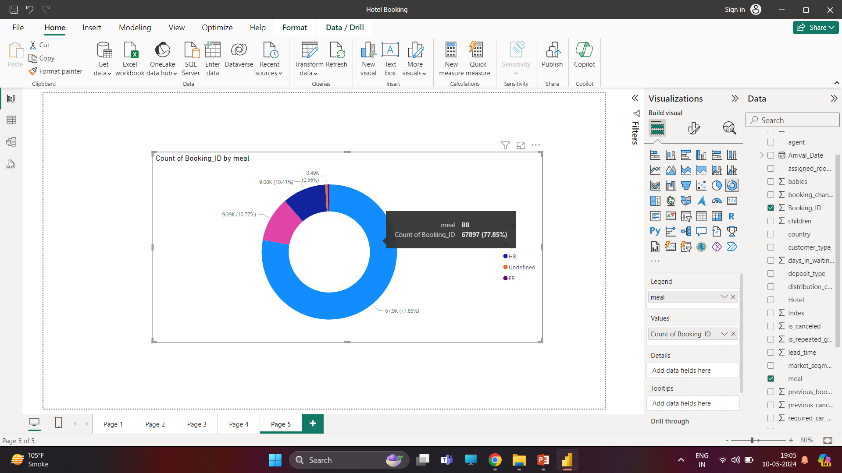
Data Visualization
This chart represent the preferable meal by booking of customers.
Most of the customers prefer BB meal which ratio is 77.8 in terms of percentage .

Slide 14
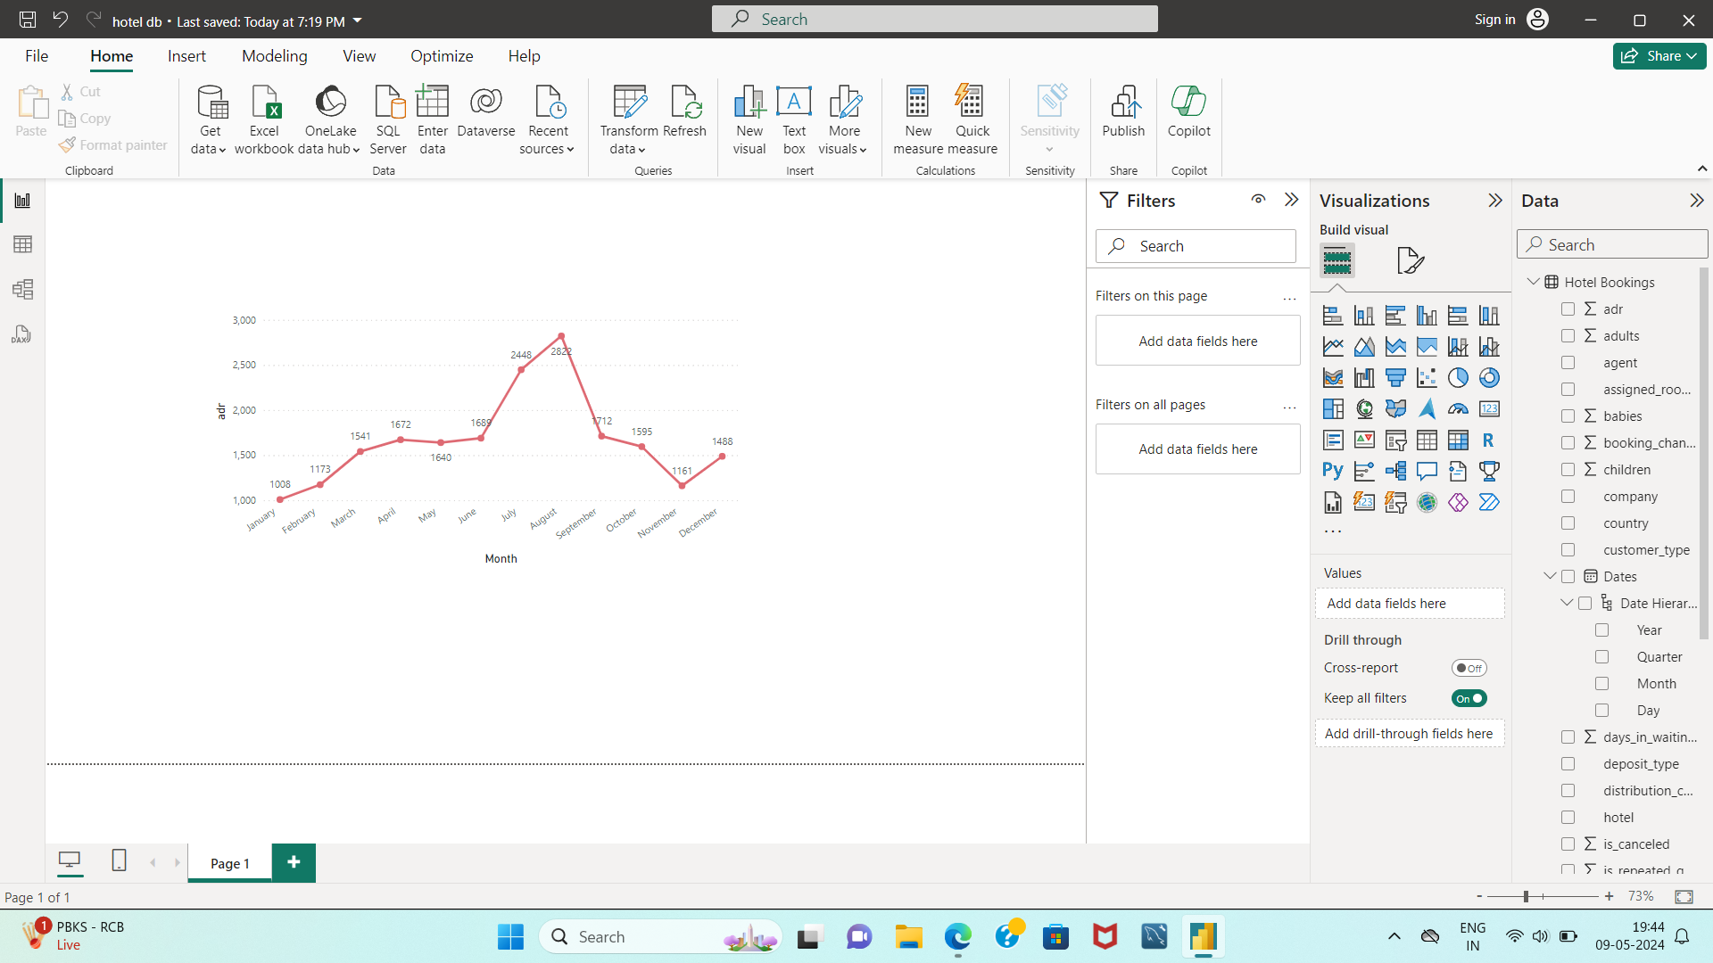
Data Visulization
This chart represent Average Daily Rate according to Date Of booking.
Maximum number of booking show in month of August.
Minimum number of booking show in month of January.

Slide 15
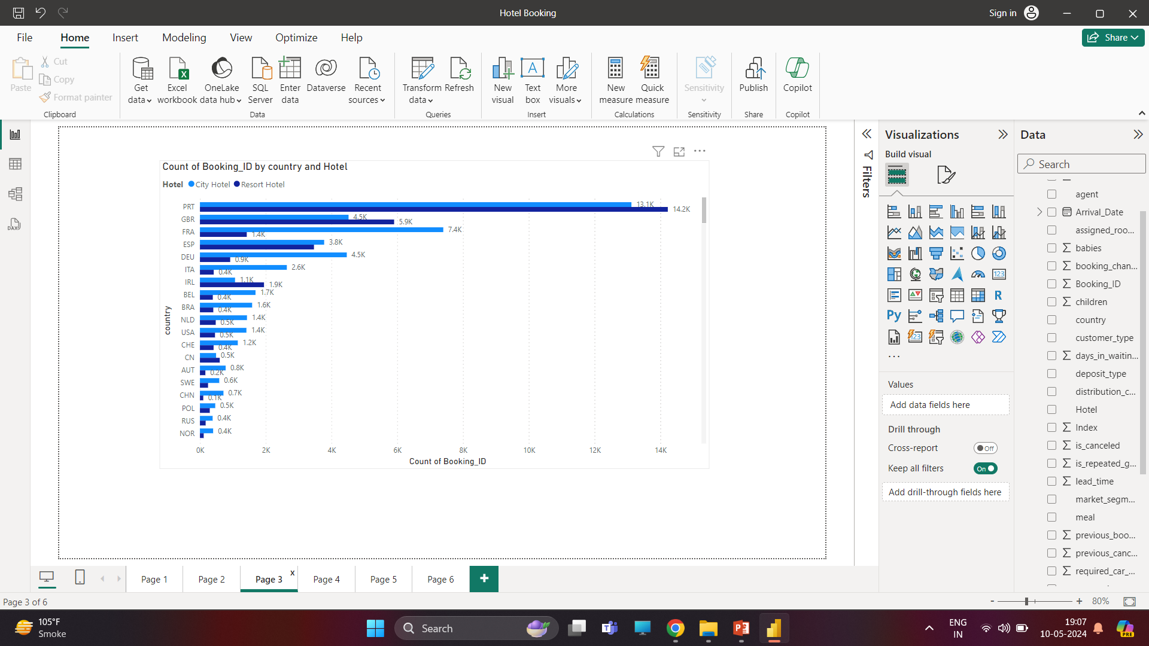
Data Visualization
This chart shows that from which country the bookings are done at high rate.
And also type of hotel booked by each country.

Slide 16
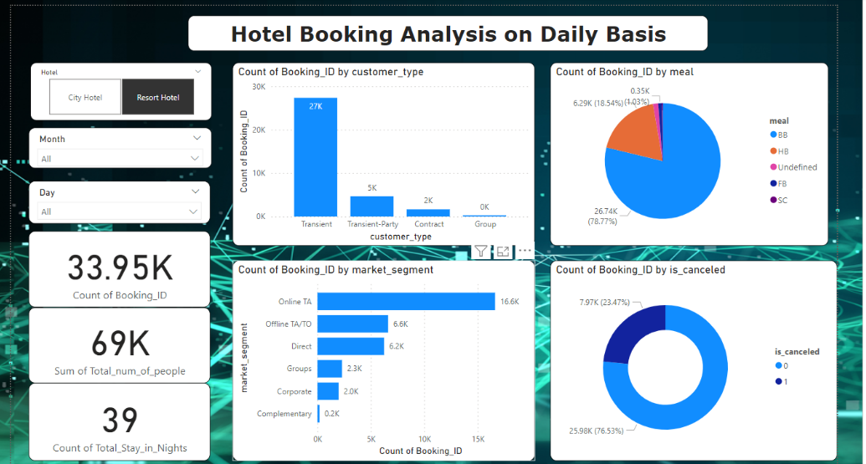

Slide 17
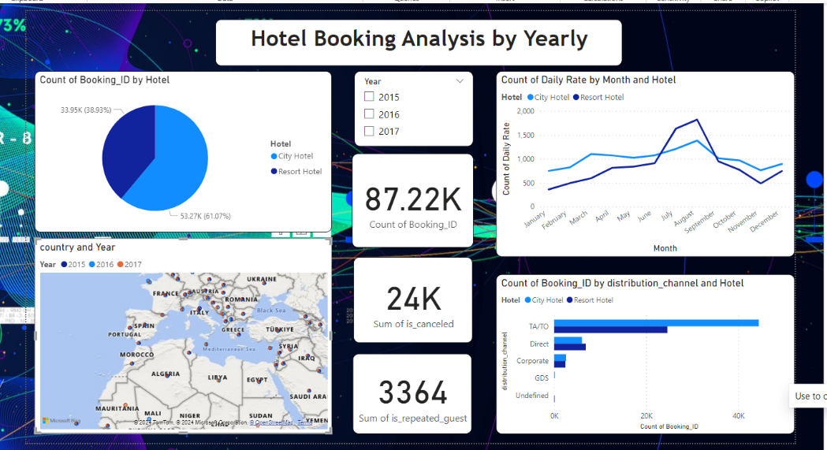

Slide 18
Conclusion
Majority of people prefer A-room type so hotels should increase their numbers to get more revenue.
Chances of cancellation is high when there are no deposits taken by hotels, so hotels should take minimum deposits to minimize the rate of cancellation.
Maximum number of bookings are in the month May to August, so hotels should provide exciting deal to customers to increase their booking in off season. As hotels are getting less repeated customers so management should take customer’s feedback and improve the hotel facilities to increase the count of their repeated guests.
Every year there is 25-30% cancellation for resort hotels and 40-45% cancellation for city hotels.

Slide 19


